Slide 1
Sudoku
By: Christopher Taylor

Slide 2
Game Description
Single player
Must fill each row, column, and box
Three difficulties
Lots of other buttons

Slide 3
Hold Up Let’s Run It

Slide 4

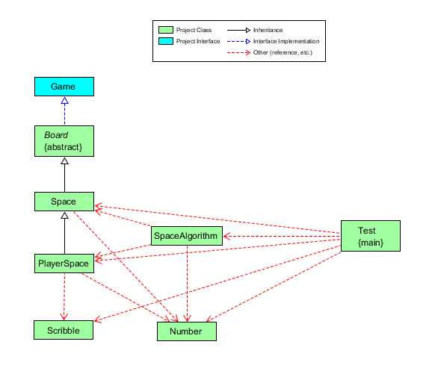
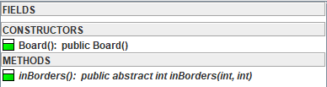
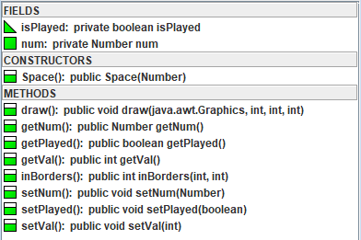
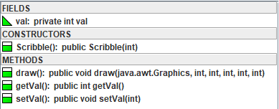
UML Diagrams
Game
Board
Space
Scribble

Slide 5
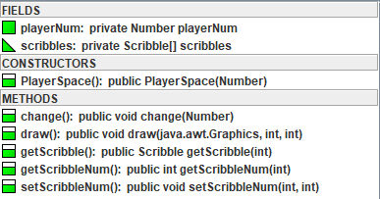
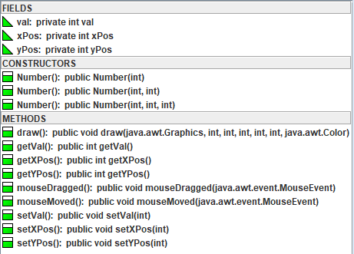
UML Diagrams (cont.)
PlayerSpace
Number

Slide 6
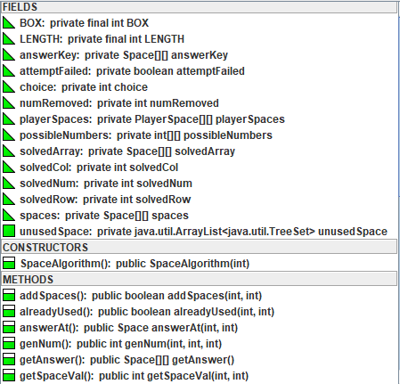
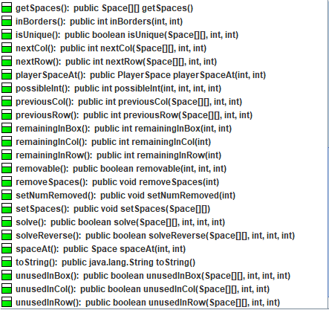
UML Diagrams (cont.)
Space Algorithm
Space Algorithm (cont).

Slide 7
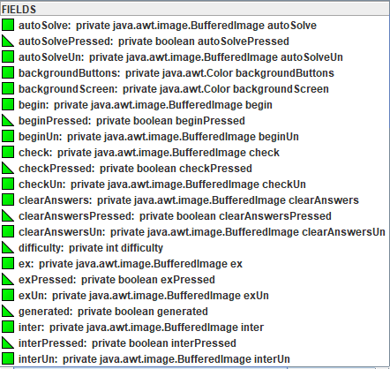
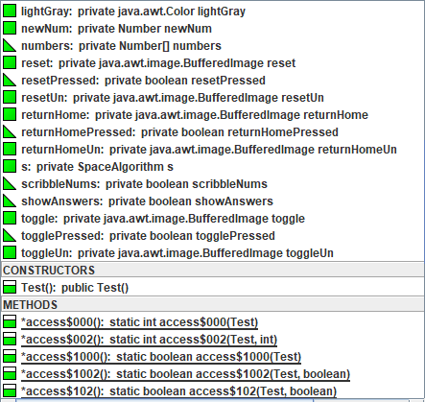
UML Diagrams (cont.)
Test
Test (cont.)

Slide 8
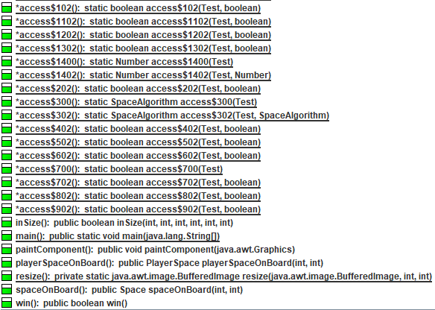
UML Diagrams (cont.)
Test (cont.)

Slide 9
Classes/Objects
Game – Interface.
Board – Abstract Class.
SpaceAlgorithm – Generates board.
Space – Unchangeable number.
PlayerSpace – Subclass of Space that allows changes. Contains Scribble array.
Number – Takes the place of Integers. Implements MouseMotionListener.
Scribble – Stores an Integer, position dependent on PlayerSpace.
Test – Draws all objects, runs the SpaceAlgorithm board generator, uses MouseListener to detect interactions.

Slide 10
Class Interactions
Space
Space uses both Board and Game’s abstract methods.
PlayerSpace
PlayerSpace overrides Space’s draw method. Draws Scribble Objects.
SpaceAlgorithm
SpaceAlgorithm creates Space and PlayerSpace array. Both Space and PlayerSpace use Number class.
Test
Test creates SpaceAlgorithm Object. Draws Space, PlayerSpace, Number, and Scribble on the screen. Number Object modifies PlayerSpace array on screen. Number Object modifies Scribble array on screen.

Slide 11
Inheritance Structure
Game – contains methods that are necessary to all games.
Board – contains methods necessary for a click-and-drag board game, implements game.
Space – Basic space, a tile on the game board. Extends Board.
PlayerSpace – Special space that can be modified. Extends Space.

Slide 12
Polymorphism
The code is able to differentiate between the Space class’s getVal() method and the Number class’s getVal() method.

Slide 13
Special features
Can create a completely unique board every game.
Can solve the board automatically for you with a button.
Can highlight incorrect spaces with a button.
Can clear all answers with a button.

Slide 14
Known Bugs
No known errors

Slide 15
Conclusion
Difficulty Level – 8/10.
“Fun” Level – 10/10.
Final Product – Because Sudoku is largely a thinking-type game and doesn’t require much animation, I focused more on the inner-workings of the game and was pleased with the results.
What I learned – I learned about new classes, such as MouseListener, MouseMotionListener, and TimerTask. I also learned about the thought process behind making a Sudoku board, such as techniques on checking solvability and uniqueness.

Slide 16
Y’all Got Questions?

Slide 17
Outside Code
http://www.java2s.com/Code/JavaAPI/javax.swing/JPaneladdMouseListenerMouseListenermous.htm
https://gist.github.com/wingyplus/2281262
https://www.java-forums.org/java-2d/533-how-draw-thick-line.html
https://stackoverflow.com/questions/18249592/how-to-change-font-size-in-drawstring-java
http://www.mathcs.duq.edu/simon/Java6/uiswing/events/mousemotionlistener.html

